Slide 1
Poker Rule Induction
Tae Hong, David Tang, Rafael Mendoza, Andrew Gonzalez

Slide 2
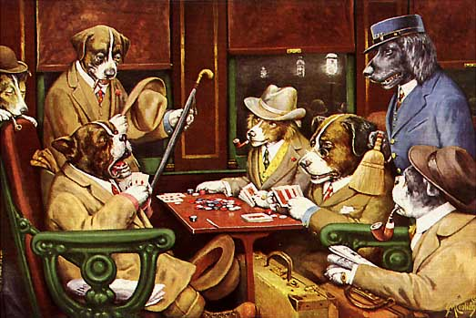
Project Description
Derived from the Poker Rule Induction problem from Kaggle
Detect poker hands with the machine-learned model
Image source: https://www.kaggle.com/c/poker-rule-induction

Slide 3
Data
S1 | C1 | S2 | C2 | S3 | C3 | S4 | C4 | S5 | C5 | hand
4 | 9 | 2 | 1 | 2 | 2 | 4 | 7 | 2 | 8 | 0
1 | 11 | 4 | 1 | 3 | 7 | 4 | 11 | 2 | 1 | 2
Each row is a hand of five cards with a given Suit (S#) and Rank (C#)
Suits (1-4):
Hearts (1), Spades (2), Diamonds (3), Clubs (4)
Ranks (1-13):
Ace (1), 2, 3, …, 10, Jack (11), Queen (12), King (13)
Hands (0-9):
Nothing (0), One Pair (1), Two Pairs (2), Three of a kind (3), Straight (4), Flush (5), Full House (6), Four of a Kind (7), Straight Flush (8), Royal Flush (9)

Slide 4
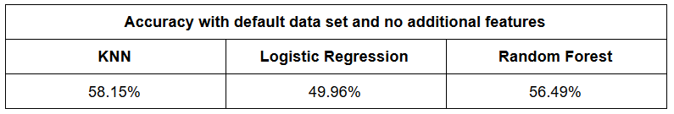
Developed Methods and Algorithms
Cross validation (cv = 10, scoring = ‘accuracy’) on:
KNN (k=30)
Logistic Regression
Run Random Forest (n_estimators = 10)
Results:
Notes:
Fair evaluation of models by ensuring fair splitting of data

Slide 5
Improving Accuracy
Added features to the dataset
All poker hands consist of a combination of: pairs, triples, four of a kinds, straights, and flushes
Features for these hands were added first
For the higher ranking hands, we added:
Top end straights (a straight with 10 through Ace) and straight flushes
Random forest number of trees (n-estimators) increased to 50
This was ran on the original data (Kaggle)

Slide 6
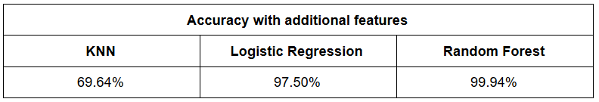
Results for Additional Features
Random Forest had the most reliable results

Slide 7
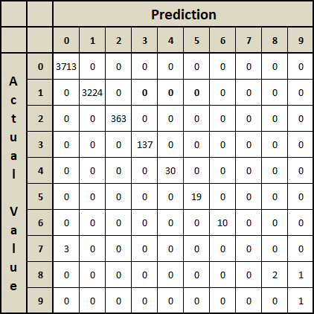
Confusion Matrix (Original Data)
Columns 0-9 represents each poker hand:
Nothing (0) to Royal Flush (9)
True results (prediction matches actual value) at (0,0), (1,1), (2,2), …, (9,9)
False results at other squares
Uncertain about sensitivity for highest ranking poker hands

Slide 8
Adding Data
High ranking hands lack data entries
Poker hand data entries are easy to create and label
Data added to improve sensitivity of higher ranking hands
Straights, Flushes, Full houses, Four of a kinds, Straight Flushes, Royal Flushes
Took caution in making sure hands data did not repeat

Slide 9

Confusion Matrix (Additional Data)

Slide 10
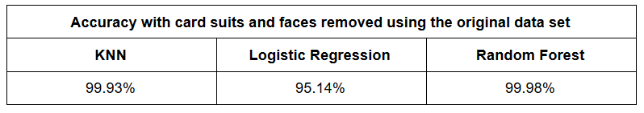
Removing Features
To further improve accuracy/sensitivity, remove original data features
C1 ~ C5, S1 ~ S5
Gives more weight to newly added features

Slide 11

The Perfect Score
Improved feature set + additional data =

